Slide 1

Inventory Management System
By:
Ethan Pedrick, Devin White, Nhat Nguyen and Jake Staas

Slide 2
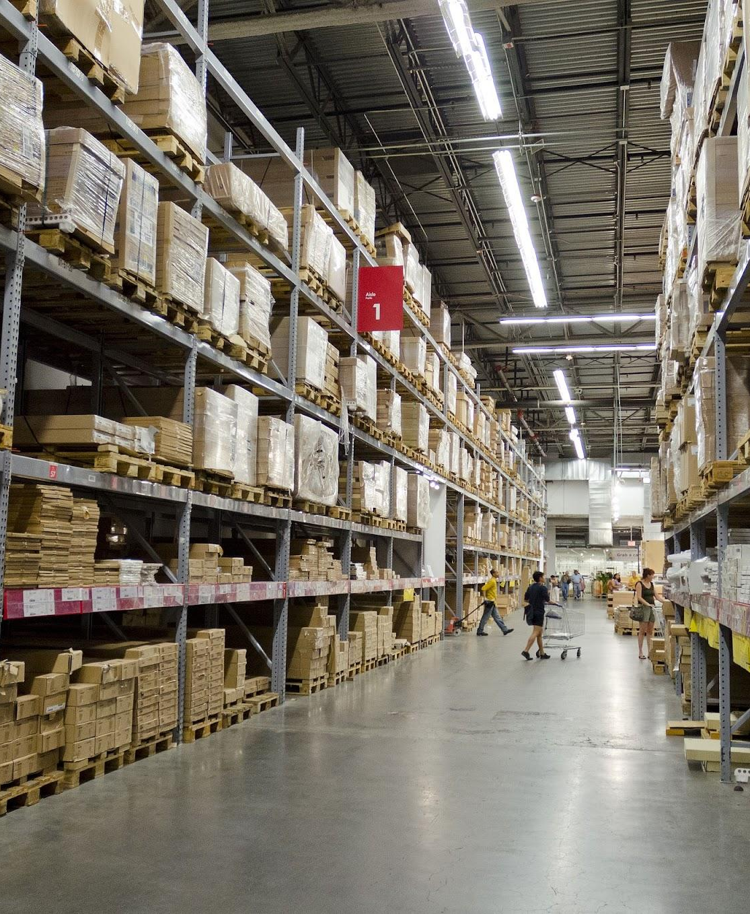
Overview Topics
Introduction
Project Management Plan
Requirement Specifications
Architecture
Database Design
Test Management
Conclusions

Slide 3
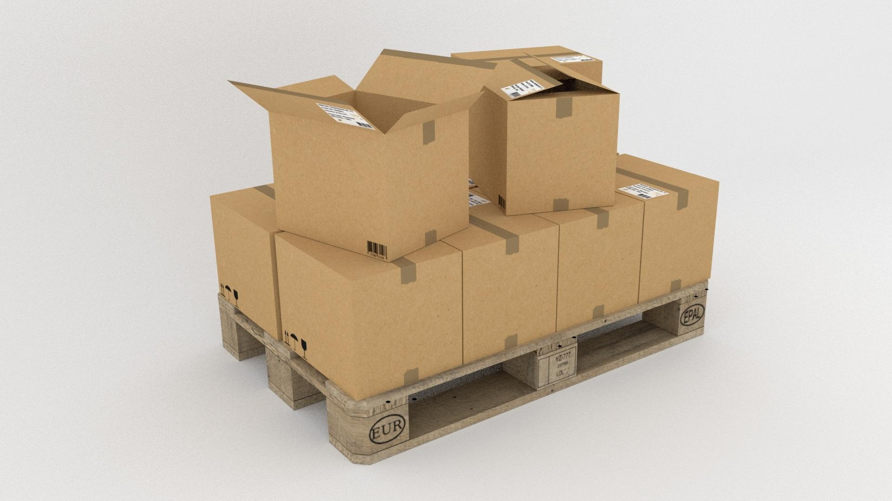
Introduction
Capabilities that include inventory control, order management, reporting, and integration of their needs with use cases for companies with stock that need to be monitored and tracked within the system.
Use-case scenarios such as distributors that will be able to use our system to track inventory and purchases, and to monitor and guide their product movement between like users and outside companies.
The purpose of this program is real-time stock tracking which can help businesses manage and monitor inventory through our system.

Slide 4
Project Management Plan
Ethan Pedrick (Backend), Nhat Nguyen (Database),
Devin White (Exe/Testing), Jake Staas (UI)
Project Organization
Our project organization consists of 4 students who each took on a task to help further the project. We assigned roles based on the strengths of each individual student and met up across the weeks of the projects to work together and help each other out with each part of the project.
Risk Analysis
Data loss or corruption – High risk. If data loss occurs due to memory issues or system crashes.
Unauthorized access/data breach – High risk.
System downtime during peak hours – High risk.
Inaccurate inventory data - Medium risk.
2.4. Hardware and Software Resource Requirements

Slide 5
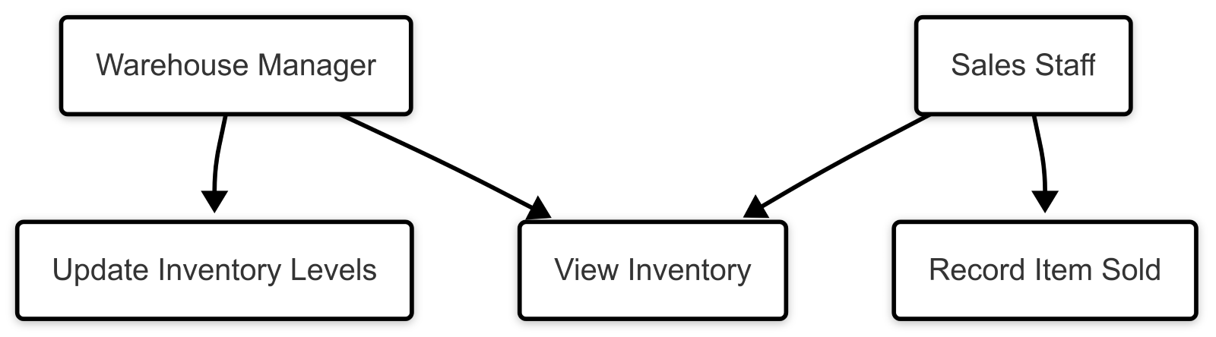
Requirement Specifications
Able to update the data in real time
Needs to be available 99% of the time
UI needs to be simple and easy to use and understand.
Non-functional Requirements
USE CASE MODEL

Slide 6




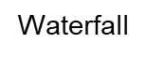
Architecture
Waterfall
Agile

Slide 7
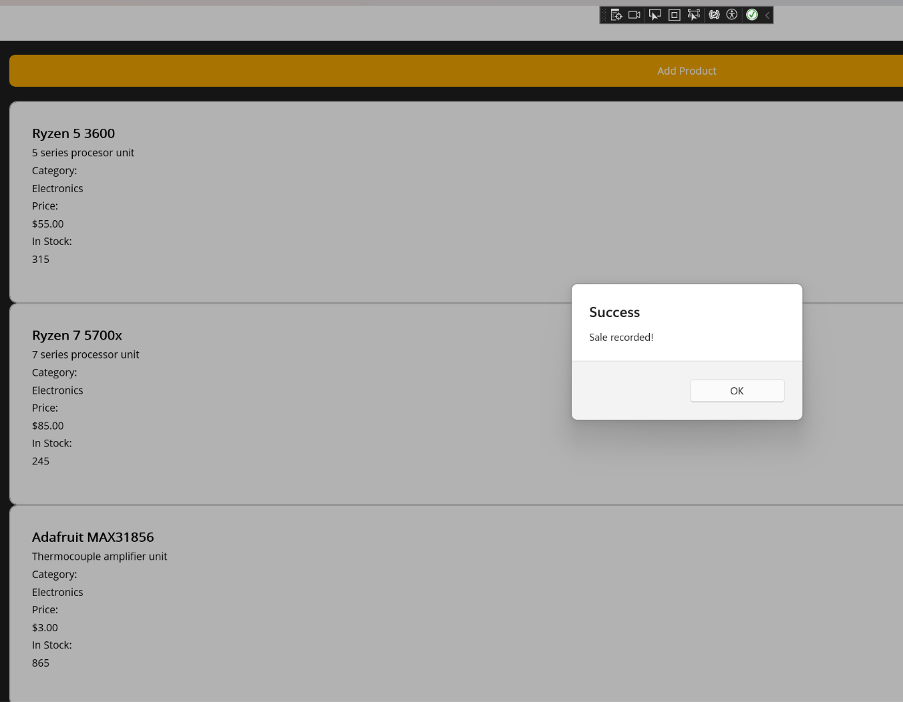
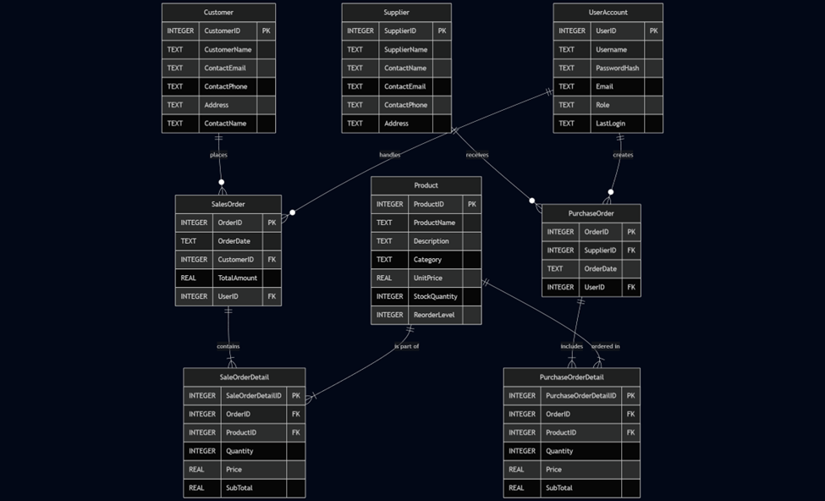
Design
User Interface design
The UI is designed in Visual Studio utilizing .NET MAUI and written in C sharp and XAML for the design specifications for each page. Upon startup, the user is greeted with a login screen that will accept their user information and allow them to log in and view the products in their inventory.
Components Design
Buy, Sell, Add, and Remove are all dynamic events that will call into the backend to make active adjustments to the database stored values. The biggest static element to this product is its initial launch past the login screen on the main page, because everything is displayed on the first boot.
Rationale for the Detailed Design Models
The waterfall design model was chosen because we wanted to create a simplistic base that we could build upon and use for further parts of our code to create a system that we would be proud of.
Database Design
The database is a SQLite formatted table-based system, It contains several main tables, a sequencing table, and the corresponding marker tables

Slide 8
Test Management
Backend Test Cases: The backend can be tested by calling each function and ensuring it reads and writes thoroughly.
Database Test Cases: The database is indirectly tested with every function, as you can check to see if it received the data change by adding and removing data to the database, and seeing if those changes are processed
UI Test Cases: We used and tested every element on the UI to see if it responded well to each interaction and did not lead to any bugs. We also wanted to check if our UI is simple and easy to understand, with basic navigation and processes.
System Test Cases: The most important element that was tested was how the system interacted altogether because the UI could work while not receiving updates from the database, or our functions from the backend could not be called by the UI.

Slide 9
Demonstration of live product updates

Slide 11
Demonstration of ordering confirmation email prototype

Slide 12
Conclusions
We learned a lot from this project, like applying the architectural models, styles, and patterns we learned across this course, which made the development process easier to manage and schedule the tasks.
In the future, we could introduce an absolute ton of new content and more pages to access, like more information regarding suppliers, consumers, and more email routing with updates.
We looked forward to applying what we learned and our experience on this project to real-world experiences.
Lessons learned and applied

Slide 13
Thank You!
Any Questions?

